Slide 1
TCS BI Engagement Workshop
27 September, 2017

Slide 2
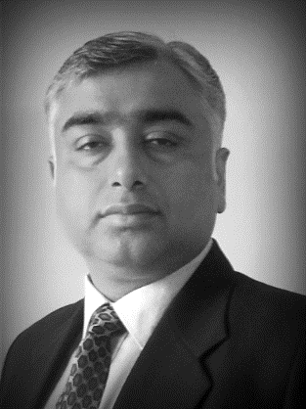



Team with you
Mr. Nitin Singla – Key Account Executive
Ms. Shashibala Bhojani – Customer Leader- TCS BPO Delivery
Mr. Deven Babre – Offering Head- TCS CDM Services
Ms. Varsha Mahajan- Subject Matter Expert/ TCS- BI Project Manager-BioStats & Prog
Ms Charusheela Thakur- Functional Consultant- iSTAMM – MRT Project
Ms. Richa Arora- Consultant – TCS BI CDSS
Over the Phone
Vijay Thukral
Global Delivery Partner - BI
Arghya Chattopadyay
Offering Head- Biostats & Programming
Mayank B
Product Owner
MRT Platform
Tushar S
Business Owner
MRT Platform

Slide 3




Agenda
TCS – CDSS Engagement
TCS – CDM Engagment
TCS Capabilities / Competencies & Collaborations with other sponsors
Synergy opportunities within and across BDM & CDSS
Session-3 | MRT Roadmap & MDR Walk through
Session-3 | MRT Roadmap – ADaM Approach
ADaM Governance & Life Cycle Management
ADaM Transformation
Synergy - Combined SDTM & ADaM MDR

Slide 4
TCS – CDSS
Engagement Overview
27 September 2017

Slide 5
Agenda
TCS – CDSS Journey
Services Landscape - CDSS
Key Highlights
Service Integration & Continuous Improvements Framework
Key Instances – Service Integration & Value Additions
Key Performance Indicators

Slide 6
TCS CDSS Journey
Multiple applications added across Clinical , Regulatory Business within VTCoE
Increased footprint in BI strategic transformation program
Training Services started in Clinical & Regulatory business area
Expansion of Validation, business support and training work in Cornerstone program, ClinRep – MOZART & TRAT
Validation activities started for BRAVE initial release
New Services - Periodic Review, Business Process Management and Document Coordination started
Training Services and Support services kicked off for BRAVE
2011
2013
2015
2017
2010
2012
2014
2016
Started Validation & Testing Services (VTCoE) with 1 application in Clinical business area
Majority of Clinical applications validated by TCS
24*5 Business Support started in Clinical , Regulatory & Pharmacovigilance areas
Established Service Integration Framework for driving synergies across services
Kick-started process definition & modelling for BRAVE
Initiated OCM Consulting and Business Analyst roles in Cornerstone program Validation
Training services started for GEM in Medicine area
Validation of initial release completed for BRAVE
Business Process Modelling, Requirements Engineering and Project Planning executed for BRAVE
Training Services started for IFC, LeVA and RBQM
Requirement gathering for One CRE
Process Modelling for RBQM
Increasing presence across different areas and harmonized processes – leading to multifold synergies and value additions to BI

Slide 7





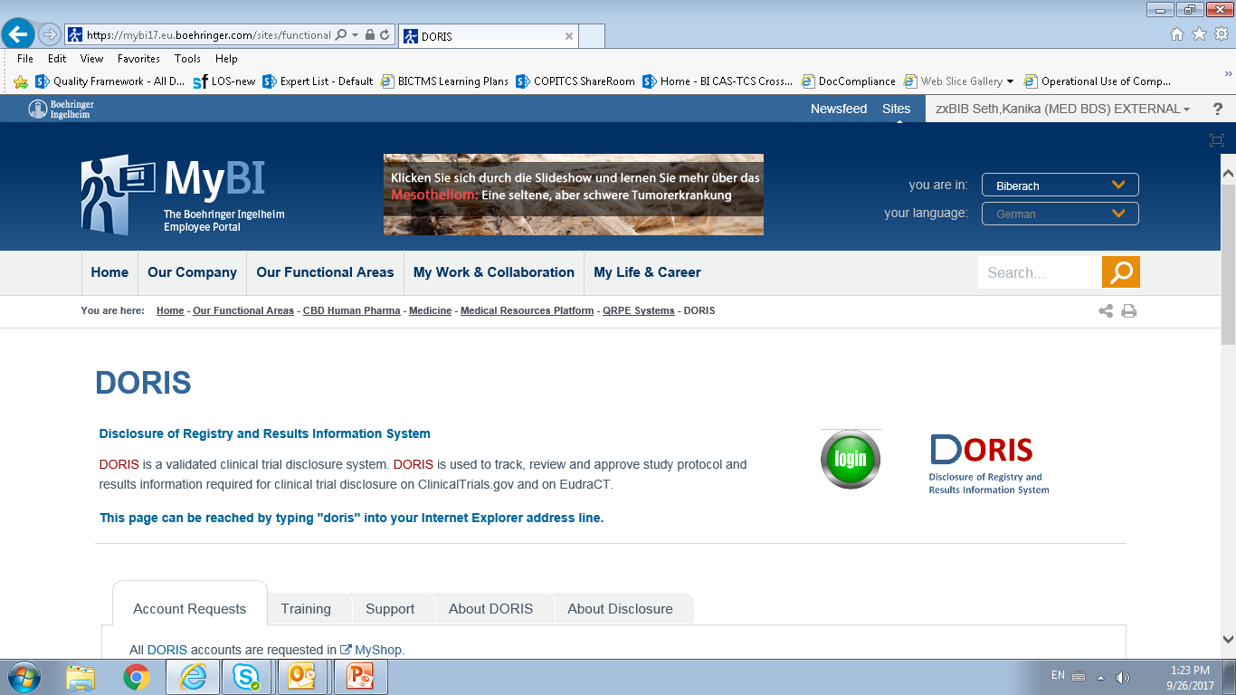




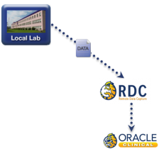
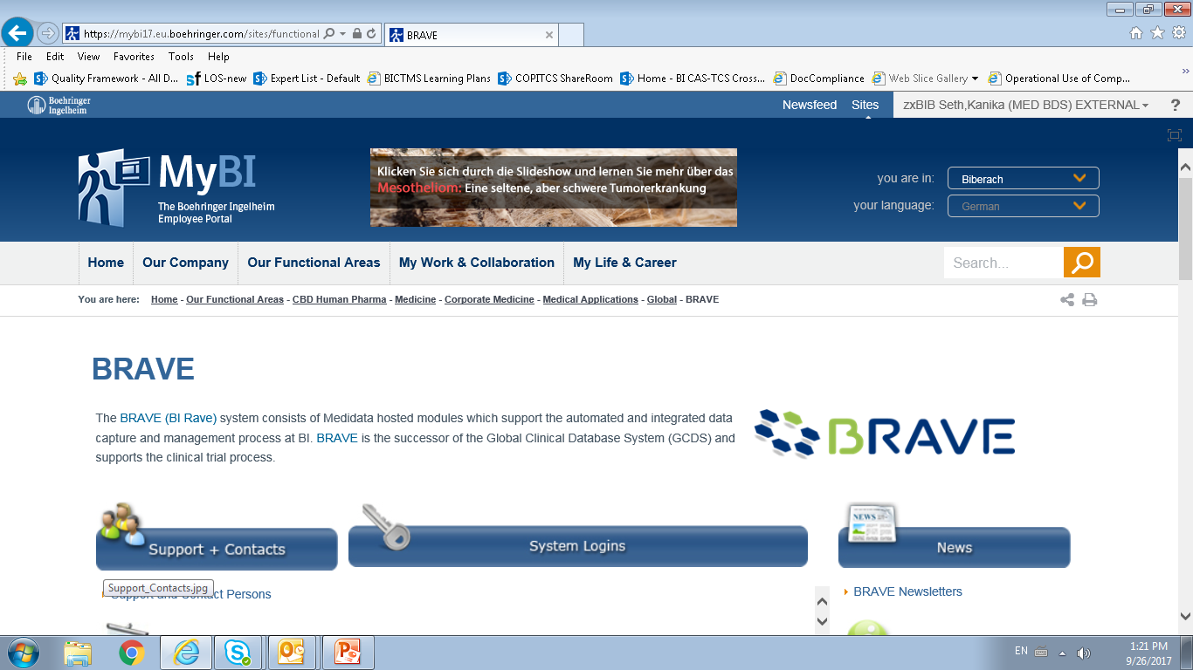


Service Landscape - CDSS
Team size of ~70+ with offshore leverage of over 95%
2010
2012
2013
2017
Validation & Testing Center Of Excellence
Business Support Services
Training Services
Business Process Management Service
Test objective creation
Test Case Authority & Acquisition
Informal/Exploratory/Sanity Testing
Periodic Review
Validation Test Mgt Services
Document Coordination
Incident Management
Problem Management
Business Process Monitoring
Service Requests Management
Knowledge Management
Learning Need Assessment
Curriculum & Course Design
Training Material Development
Training Material Maintenance
Training Delivery
Requirements Gathering & Authoring
Business Process Modelling
Business Process Maps Creation
Key Activities
Involved in ~75+ Releases / Change Controls / Patches
17000+ Test Case Authoring
2000+ Test Objectives
22000+ Test Case Executions
97000+ tickets resolved
44000+ Service Requests
12000+ Monitoring Items
750+ Knowledge articles created/ updated
10000+ unique users serviced
18000+ minutes of ILT / VILT
400+ CASpedia Pages
2000+ Minutes of WBT
Process Maps creation in progress for 14 Expert Areas identified.
Key Facts

Slide 8
Key Highlights
Shift – Left
Growth & Expansion
Going up the Value Chain
Process Optimization & Continuous Improvement
Service Integration
Early involvement in Columbus Program and BRAVE leading to smooth delivery with very limited BIs operational involvement
Increase in application landscape within CDSS and others
Expansion in existing scope of services - CARE macro installation, ETD Support etc.
Increase in service landscape - Business Process Management, Periodic Reviews, Document Coordination etc.
Validation Manager Support provided in BRAVE and CDR
Training Lead for CDSS
Additional responsibilities like Overall Project Planning, Database Design, Compliance Testing, Process Modelling, Requirements Updates etc. taken up
Significant effort reduction at BI’s end through Process Optimization and Value Additions
Proactive Risk Assessment of BI application landscape to identify vulnerabilities and risks through TCS Rigor in Operation (RIO) initiative
Automation of various operational activities to avoid human error and improve operational efficiency
Focus on synergies across the services to reduce BIs effort, Cycle Time and improve overall quality
Increased collaboration between Business Support Team and IT Team leading to better outage management and effective problem management
Seamless onboarding of CDM associates through efficient knowledge sharing and best practices

Slide 9
Service Integration and Continuous Improvement Framework
Integrated quality team and defined output quality standards
Continuous improvements focused across multiple themes
Quality
Management
Productivity Improvements
Through robust knowledge & competency management, automations, optimal team utilization
Aligned and integrated governance structure within and across services
Service Integration & Continuous Improvement
Standardization of operational processes
Process
Optimization
Effort Optimization
Through Shift Left initiatives, synergies across services & problem management initiatives
Governance
Quality Enhancements
Through robust quality management framework, process harmonization & usage of reusable assets
Integrated knowledge management framework
Knowledge
Management
Standardized communication
framework and well-defined roles and responsibilities
Communication
Engagement Management Office (EMO) aligns operations with 5 enablers of the Service Integration and Continuous Framework

Slide 10
Service Integration and Continuous Improvements – Key Instances
~200+ Value additions and Synergy instances across services provided to BI leading to :
Productivity Improvements
Effort Optimization
Quality Enhancements
Created SAS programs to check trial entry structure issues, leading to 100% reduction in outages because of this issue
~60% Cycle time reduction in access management for a ~100 user base, by training team directly owning the attendance closure and certification process
Reduced maintenance life cycle by ~10% for multiple training materials by proposing updates during ILT sessions and not through maintenance
Joint Knowledge transitions across services for multiple projects (~15 projects) leading to optimized BI Expert efforts(~60%)
40+ Knowledge sharing sessions across services leading to BI Expert Optimized efforts
New functionality implemented to ensure seamless course completion marked in LOS - 100% reduction in efforts of the Support Team in resolving training completion related tickets
Reduced BI Expert review effort (~30%) - by implementing review comments provided in one training material into other training materials; by conducting workshops for the deliverables
Improvement in Defect management process to reduce BI effort in analysis and tracking of defects - overall effort reduction ~50%
Automation of metadata compliance through SAS macros leading to 10% reduction in effort and cycle time
80+ Processes optimized across services leading to quality improvements and synergy enablement
Continuous Focus on RiO – A TCS-wide initiative towards Rigor in Operations led to identification of 4 Major risks in BI processes by TCS teams
VTCoE and Support Services involved in review of Training deliverables (9000+ Minutes of WBT)
VTCoE team involved in the CASpedia content creation (~400+ CASpedia Pages)
Training Services helped Support Services in resolving Tickets related to LOS issues
Support Services team assisted in setting up of CRO Data Load for Training Services in CDR Test environment
Increase in traceability and completeness of accesses in the access tracker in the Clinical Data Warehousing area

Slide 11







Key Performance Indicators
KPI : VTCoE
KPI : Support Services
KPI : Training Services
Test Case Authoring defects
Test Case Execution defects
On Time Estimations
On Time Delivery
% of deliverables rescheduled
Project Pipeline
# of value adds
First feedback on Ticket
% Customer & Expert Hops
%age of tickets resolved within 24 Hrs
Escalation to the next support level
Knowledge Base Utilization Trend
End user feedback
Timely delivery of monitoring report
Reachability of support personnel for voice support
% of monitoring items execution / evidence were missed on planned day
Adherence to the committed timelines for delivery of training material(s) as per the planned dates
% of deliverables rescheduled
Development/Conceptualization (Functional Defects)
Timely Status Reports (Weekly & Monthly)
% of pipeline items rescheduled
RAG Legend
On Target
Under Control/ Minor Issues
In Trouble/ Major Issues

Slide 12
BI -TCS CDM BPO
Engagement Overview
27 September 2017

Slide 13
Agenda
Key Highlights - CDM
Delivery Overview
People Overview
Performance Metrics - CDM
Process Improvements- CDM
Key Highlights – Statistical Programming
Synergies

Slide 14
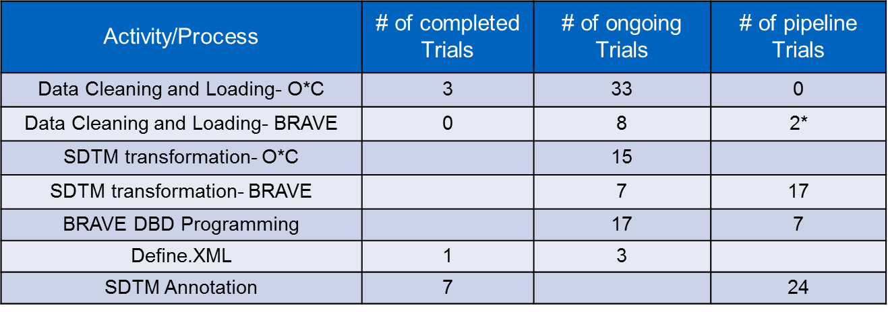
Key Highlights: Delivery Overview- CDM
CDM BPO- Volumes
CDM BPO- Milestones:
SDTM transformation snapshots achieved: 8 Trials
2 BRAVE trials in PROD- Go live
Migration completed for 3 BRAVE trials
Audits:
1 Audit by Abbvie for 1311, zero findings

Slide 15
Key Highlights: Delivery Overview- Other Projects
CBO reconciliation activity
Started with 3 (senior + junior) SAS experienced resources in the CDM BPO
BI- India PASS trials
3 trials on TCS platform- 2 live and 1 in contract stage
iSTAMM Project- MDR + CDT
Conference room Pilot 1 in last week- 18th-22nd Sep
CDSS- CDM Collaboration Project
Database Designer; CF programmer to work closely with CDSS for implementation of BRAVE strategy
SGA Resource
1 TCS resource to start SGA training at Germany for 3 months from Jan/Feb 2018
Additional SGA resources @ offshore to be trained via TTT

Slide 16
Key Highlights- People Overview
CDM Resources: Pilot initiated with 21 FTE, Currently we are a team of 81!
In addition- we have 3 Statistical Programmers for the pilot 1366.4 trial

Slide 17
Performance Metrics

Slide 18
Key Highlights: Statistical Programming
1 pilot study awarded 1366.4
Training – LOS; CARe Sand box Hub n Stub trng; X-Macros
Study kick off done on 22nd Sept
Protocol, SAP & Mock shells review
Upcoming Milestones:
Review of Annotated SDTM CRF & Validated SDTM data sets- Oct 2017
1st MQRM & 1st DEC meetings- Dec 2017
Audits:
Vendor Qualification Audit completed

Slide 19




Process Improvements- CDM
Area | Synergy areas | Benefits
SDTM – DBD Synergy | OCV Tool- Comments carry forward | Increased accuracy and enhanced Productivity
Data Cleaning | SAS macros for data cleaning (Lab Reconciliation | Increased accuracy and enhanced efficiency
Data Cleaning | Queries on non-enterable fields | Better Quality and decreased cycle time for queries
DBD-SDTM | PDF Annotation Tool | Increased accuracy and enhanced efficiency
SDTM | Creation of SDTM Overview Macro in SAS to check input availability | Better Quality and decreased cycle time
SDTM | Auto-consolidation of multiple specification excel files by VBA | Increased accuracy and enhanced Productivity
Cycle Time Reduction
Cost Reduction
Quality Enhancements
Customer Satisfaction

Slide 20
TCS Capabilities / Competencies & Collaborations with other sponsors
27 September 2017

Slide 21
Agenda
TCS LS & HC Portfolio
Clinical Development Services
TCS Factsheet- BDM
Collaborations with other Sponsors
Potential Areas of interest for BI
BDM Cross functional synergies & benefits
Current Cross Domain Synergy- BI

Slide 22


TCS Life Sciences & Healthcare Unit Profile
People - our Biggest asset 24,000+ consultants including
4,400+
Associates in
Clinical Services KPO
1,100+
Associates in
Medical Device engineering
1,800+
Life Sciences SAP Associates
Significant percentage of Domain consultants e.g. Physicians, PhDs, Biomedical Engineers, Pharmacologists, & Pharmacists
Sustaining Long Term Relationships
Pharma Companies
14 of the top 15 Pharma Companies
Medical Device Companies
8 of the top 10 Device Manufacturers
Payers
3 of the top 6 US Payers
Providers
Large Diagnostics Labs in US and India
Large Hospitals in US, UK, Canada and India
Distributors
3 of the top 3 Distributors
Pharmacies
3 of the top 3 pharmacies in the US
Full Services Play in IT, Consulting, KPO , Infrastructure and Engineering Services

Slide 23
Life Sciences – Broad Portfolio of Offerings
IT Services
Business Process Outsourcing
IT Infrastructure Solutions
Platform Services / BPaaS
Outsourcing Solutions
Enterprise Solutions
Technology Solutions
Migration Solutions
Clinical Operations Services
Risk Based Monitoring
Clinical Data Management
Biostatistics & Programming
Medical Writing & Medico Marketing
Regulatory Affairs
Pharmacovigilance
Medical Affairs
Horizontal Solutions
Finance & Accounting
HR Outsourcing
Sales Order Management
Supply Management Solutions
Infrastructure Outsourcing
Network & Integration
Hardware Installation & Support
Clinical Services
Drug Safety
Regulatory Services
Engineering & Industrial Services
Consulting
Assurance Services
Medical Device Engineering
New Product Development
Product Lifecycle Management
Regulatory & process quality services
Pharma Manufacturing IT
Enterprise Transformation & Change Management
BPM
Systems & Application Architecture
Functional Landscape Assessment
IT Process Management
Outsourcing
Transformation
Verification Services
Validation Services
Niche Testing Services – Mobility Testing, ERP.
New Initiatives & Offerings
Expansion of LS Clinical Services Platform to include Drug Safety and Regulatory
Medical Device Solutions leveraging Mobility, Social Media and Big Data
Emerging Market Advisory For Medical Devices Industry
Manufacturing and Supply chain transformational capabilities for Medical Devices industry

Slide 24
Advanced Drug Development – ADD Platforms | Offerings
Regulatory
Compliant
Cloud
Hosted
Multi-tier
Security
Cognitive
Based
Digital
Forces
Global
Helpdesk
Archival &
Retention
Business Services
Multi Tenant
Artificial Intelligence
Machine Learning
Industry Standards
Robotic Automation
Natural Language Processing (NLP)
Advanced Analytics
Unified Data Ware House
Data Acquisition
Data Analytics
Patient Safety
Medical Adherence
Data Transparency
Seamless Integration
e-Learning
MetaData
Registry (MDR)
Integrated Data Management (IDM)
Drug Development
Insights (DDI)
Integrated Centralized
Monitoring (ICM)
Clinical Data
Transformation (CDT)
Connected Clinical
Trials (CCT)
Integrated Patient
Safety (IPS)
Auto Narrative
Writing (ANW)
powered by : TCS Decision Fabric “A Cognitive Engine”
Outcomes Based Offering | Transfers Capex to Opex | Reduces Sponsor’s Oversight
TCS Confidential

Slide 25



Life Science BPS : Geared towards the Future…
Life Science Trends
Life Science BPS Initiatives
Big Data (e.g., genome, proteome, metabolome, microbiome, etc.), statistical analytical models and Predictive Analytics
Digital patients: Wearable devices/ Mobile health applications/
Bio-sensing technologies/ e-Consent, e-Diary/ e-PRO
Remote Trials (Chronic conditions, Geriatric population, Alzheimer's disease etc)
Cloud and Collaboration : Interconnected data and systems
Development of Biosimilar s
Real World Evidence generation
Data Transparency: Redaction and Data Anonymization
Remote and Centralized clinical data monitoring
Role of IOT: adherence data, patient monitoring, etc.
Patient Engagement through digital technologies, viz., social media
Social Media in Pharmacovigilance
Strategic and Statistically Valid decisions using novel trial designs
Clinical Trial modelling and simulation
EMR/ EHR integration: Integration of patients, providers, payers and regulators)
Offerings around Risk Based Monitoring, HEOR, Social Media listening, Digital marketing
Centralized Monitoring with Real time data and E-Source technology
Data Visualization and integration to leverage big data & analytics
Global CMC writing & Product Registrations management (IDMP)
Novel trial designs and their implementation
Quantifying Real World Evidence for Regulatory Decision Making
EMR/ EHR integration
E-Source
Cloud services for data integration
Metadata Repository and Transformation- PRM to eCDT submission
Connected Clinical Trails Platform
Mobile health applications
Evolving
offerings
Evolving technology
Evolving
Talent
Data Analysts/ Scientists
Patient caregiver empowerment
Data standards expert
IOT/ Cloud experts

Slide 26


TCS BDM - Biostatistics and Statistical Programming & Clinical Data Management Factsheet
BDM
~1,320
Team strength
65
Number of Biostatisticians
12+ Years
Service Experience
245
Number of Statistical Programmers
10
122
SAS Certified Professionals
Global Sponsors
~1,100
Clinical Data Managers
280+
Associates who are CDISC trained
28
TCS Biometrics SOPs
Medidata Accredited Partner
Applications Experience - OC RDC , Inform, RAVE, Proprietary Client Systems, TCS IDM and Data Transformation Platform

Slide 27
End to End BDM Service Offering
CRF Design & eCRF Build
eCRF specification
CRF/eCRF & SDTM Annotation
CRF/eCRF Completion Guidelines
Data Management & Statistical Analysis Plan and mock shells
Randomization schedule generation
Sample Size Determination
Database Design & Set up
Edit Checks specification & Programming;
User Acceptance Testing
Third Party Data Integration
Dictionary Set up (e.g. MedDRA, WHODD)
Statistical programming input to CRF development, database design and edit checks
SDTM mapping specification
STUDY
SET-UP
Double data entry & verification
Third Party Data Loading and Reconciliation (Central Lab/ Local Lab Data, e-Patient Diary, PK/ PD data)
Medical Review
Data Review and Query Management
Medical Coding
SAE Reconciliation
Post Production Change Control; Data Migration
SAP execution
Creation of input files for non-compartmental analysis
Analysis datasets (ADaM) programming specifications
Programming and Validation of TLFs
Programming & Validation of CDISC compliant datasets (SDTM/ ADaM)
Dry runs/Data Review meetings
Support for DSMB/Interim analysis
Exploratory data analysis
STUDY
CONDUCT
Interim Database Closure
QC, Database Audit & QA
Final Database Closure & Database Lock
Conversion of data to SDTM/ Sponsor Standards
Relevant project closure documentation
Study Archival/Decommissioning & Study Data Transfer
Support for Topline results, generation of CDISC compliant datasets & TLFs
Statistical input/ review of clinical study report (CSR)
Generation of submission ready CDISC compliant datasets and e-submission package
Generation of CSR statistical appendices
Study Report Creation
Generation of CDISC compliant datasets and TLFs
Support for Electronic submissions
Data de-identification/ anonymization
STUDY
CLOSE OUT

Slide 28
Additional Tasks in Biostatistics & Statistical Programming
DSMB charters and analysis plan & execution
Project planning and coordination
Planning for integrated data analysis (ISS/ISE) and execution
Statistical input/ review of ISS/ISE dossier
Project level standard creation and maintenance
Statistical and Programming support for:
DSUR and RMP
Health authority request and advisory committee meetings
Publication support
Project Level
Activities
BnSP
Specialized
Services
BnSP
Metadata Driven Solutions
Statistical support for Chemistry Manufacturing and Controls (CMC)
Patient profile creation for narratives and data review activities
Data de-identification and anonymization of patient level data
Support for electronic submissions (eCTD, ClinicalTrials.gov, EudraCT, etc.)
Standards Management for client specific global CDISC standards
Help Desk Support
Migration Activity
System Landscape Assessment
Assistance in
Investigator Meeting
Medical Review
CDISC Consultancy
PALS
Specialized
Services
CDM

Slide 29
BDM – Selected Client Base
Sponsor 1
Sponsor 2
Sponsor 3
Client
Global Top 10 Pharmaceutical Company
Global Top 5 Swiss based Pharmaceutical Company
Global Top 5 Pharmaceutical Company
Years of Partnership
5+
10+
3+
Delivery Center
India
India
India, France and US
Team Strength
271
302
53
Platform / SOP
TCS Platform and SOPs
Client Platform, database and SOPs
Client Platform and SOPs
Application
RAVE, OC RDC
RAVE, OC RDC
TCS Internal Platform - IDM
Scope of Work
Consulting in IT sector; End to End CDM , MW, Programming, Document Publishing, MDM, Redaction. SDTM, ADaM, TLFs for late phase development, Data Anonymization, DSUR, Safety Assessment Committee (SAC), End to end Clinpharm & Medical Affairs Studies, data disclosure & e-sub activities
End to end CDM activities, Regulatory submission, expanded to new services: Narrative writing, Medical Evaluation , CTMS support, PV, Programming, MA Trials. SDTM, ADaM, TLFs, e-Sub support, DSUR, Central Statistical monitoring report generation
End to end CDM activities
Medical writing
SAP, SDTM, ADaM, TLFs, CSR inputs, data
review and surveillance reports, DSUR, DMC, e-sub activities, patient narratives
Working Model
TCS managing studies independently and working with global team
Integrated model, TCS resources are part of global team. For few projects, entire deliverables are by TCS team
TCS managing studies independently and working with global clinical teams
Quality Framework
No formal SLA / KPI for checking quality and timeline Client performs random qc
Feedback from global lead for each deliverable. Quarterly satisfaction surveys to measure engagement health
Formal SLA / KPI for checking quality and timeline.
Client performs random qc

Slide 30
BDM – Selected Client Base (Contd.)
Sponsor 4
Sponsor 5
Sponsor 6
Client
Global Top European Pharmaceutical Company
Global Top European Pharmaceutical Company
Global Top 3 Biotech Company
Years of Partnership
7+
4+
2+
Delivery Center
India and Denmark
India
India
Team Strength
33
77
8
Platform / SOP
Client as well as TCS Platform and SOPs
Client Platform and SOPs. TCS SOPs customized for certain key deliverables
Client Platform and SOPs
Application
Client Proprietary
TCS Platform and SOPs
Not Applicable
Scope of Work
End to end CDM activities , data mapping data standards/SDTM,IMP Tracking & management, ADaM, TLFs for early & late phase development, DSUR, publication support
Protocol inputs, SAP, Randomization, PK merge, SDTM, ADaM, TLFs, CSR inputs, HL7 data parsing
Statistical Analysis for Chemistry, Manufacturing and Control
Working Model
Integrated model , TCS resources are part of global team. Entire deliverables are by TCS team
Study based team of cross functional resources. TCS takes complete ownership of all deliverables.
TCS managing assigned work independently,
Quality Framework
Quality assessed based on random sample quality control. No formal SLA / KPI. Feedback from client study lead
Formal SLA / KPI for checking quality and timeline. Study based KPIs & health are monitored by TCS
Formal SLA / KPI for checking quality and timeline. Client reviews reports

Slide 31
CDM | B&SP Process Advantages
Global Standard
Final Approved Protocol
DB
Go-live
FPI
Data Trends, training sites
~50% data in
LPLV
DB Freeze
TFL
Generation
CDM
eCRF
EDC Build
Ongoing CDM activities - validation, coding, reconciliation
Pre Lock
Activities- Final
Checks & Recon
CDM
Edit Check Spec
SDTM Transformation
“Clean as you go”
3rd Party Data Agreement
Final Data
Transfer
Data
Aquistion
3rd Party Data Transfers
Achieve Right Quality and deliver on time every time
Biostats
SAP
Standard tracking and reconciliation steps
Review draft TFL's
Review Pre DBL TFL’s
Edit Check Statistical
Upfront review of draft TLFs and SDTM
Clinical
Stat
Prog.
Stat Programming Specifications
Review SDTM Extracts
Programming
SAS Macros
4-6 weeks
3-4 weeks
2-3 weeks
Outcomes with Benefits – depiction only
Process value adds

Slide 32
Case Study 1 – Value Stream Map for Clinical data management
Inform (DB2)
SAS (DB3)
Study repository
External data
Specter
KaizenRef. | Pain Area/ Challenge | Potential solution
K-1 | Programming and CDM team working in silos leading to high rework in studies | Harmonization between programming and CDM team with team restructuring- >SAS checks programmed by programming team to be validated by CDM team with re-usability of queries raised before
K-2 | Error proofing, exception handling and multiple variation in process controls There is variation in process controls | Process standardization leading to volume reduction for exception and checks
K-3 | Need to reduce High Training Time in CDM Challenges in knowledge retention and management Study issues are not shared Lack of trackers for resource utilization across studies | Cross training Inform & SAS programmers Increase in pool and knowledge of SMC’s by creating TCS SMC and Client SME link Digitization of training module led to reduction of training time Knowledge management portal developed to reduce queries raised
K-4 | Redundant records which result in lot or re-queries and effort to follow-up on validation | Identification of redundant records to avoid rework Confirmation from Client on visit mapping
K-5 | Automation of repetitive tasks in CDM Data base have to be manually coded & is tedious | Macro for LNR QC Macro for RAMOS More Exposure to EXACT
K-6 | High time taken for extraction of data and get reports for application Progress of study is unknown | TAT reduction of quest query report with added functionality incorporated in the report Frequency of automatic data extraction changed from weekly to daily
DVS (DB1)
PK
(DB4)
K1) Lack of Harmonization between programming &CDM team
Protocol
Lab Notebooks LNR- (DB5)
K5) Data base have to be manually coded , repetitive tasks in CDM
RAMOS
(DB6)
E- Diaries
Study Startup
K3) Reduce training time
challenges in knowledge retention
Study Conduct
Study Close-out
K6) High time taken for extraction of data and get reports for application
Understand protocol, DVS & e-CRF
Address auto checks fired by closing query
Address auto checks fired by closing query.
Review of each check in the DVS for any discrepancy & raise clarification
Reconciliation of Subject enrollment, Randomization number, visit, Consent Information, withdrawal Information, planned time points between e-CRF , EDU profile for labs, PK, Biomarker, ECG, PFT, e-Diaries, questionnaire data.
A functionality to freeze a casebook after all the data has been cleaned, once frozen, and signed by investigator
K4) Redundant records which result in lot or re-queries and effort to follow-up on validation
K2) Lack of process standardization leading to high volume
Program the checks
Conduct Unit testing
Conduct Cross testing
Install the forms, rules and admin files
A functionality used to lock clean forms and visits which are frozen, could be done is in-stream and at end of study.
SAS Checks are programmed to capture two or more data point/forms.
Reconciliation of critical inform datasets to clean data recorded.
SAS Checks are programmed to capture two or more data point/forms.
PA1 – Programming (20 FTEs)
PA4 – Data locking – 140 Data Management associates
PA2 – Testing (8 FTEs)
PA3 – Data cleaning – 140 Data Management associates

Slide 33

Case Study 1 - Driving business value
SN | PA No. | PA | Solution | Solution Impact | Status | Final Impact
1 | PA1- DB1 | Review DVS | Clarifications to be reviewed for alternate tabs by programmers and QCA. This way same clarifications are not asked | Irrelevant clarifications in Inform reduced from 14 % to 2 % |  | Inform programming cycle time reduced from 5 weeks to 4 weeks across studies
2 | PA1 -DB1 | Program checks | Mandate to raise 90 % clarifications within 2 days of receipt of DVS | 0 irrelevant clarifications raised in the period
3 | PA1- DB1 | Program checks | Rule wise allocation to associate instead of tab wise. The same rule with attachments need to be programmed by same programmer | Productivity for rules programming has improved from 10 to 13 per man-day
4 | PA2- DB1 | Create test scripts | Create date & time calculator for automatic date and time in core checks | Productivity of test scripts increased from 198 to 315 in Inform and 42 to 68 in SAS
5 | PA2- DB1 | Program checks | Programmer's start the DVS review and programming while the allocation sheet is getting generated | Complete least 100 checks at the first day itself by a single programmer |  | Reduced the go live TAT for a study at TCS was 30 days 6.2 days before the schedule.
6 | PA2- DB1 | Create test scripts | Peer to peer testing started after core TAB's programming | Testing cycle started earlier by 2 days
7 | PA2- DB1 | Program checks | Standard checks library have been collated & can be directly added in the study.. | Avoided reprogramming of 30 % of standard checks
8 | PA2 -DB1 | UAT | Submit ting the study to UAT earlier, 2 days after the study went to QCA, since Client is doing the UAT only for safety and coded forms. | Avoid loosing time due to ICDS set up failure at Oracle, since this will happen parallel to the QCA activity.

Slide 34

Case Study 3 - Biometrics synergy (CDM, SDTM, Statistical Programming)
Primary Objectives
To reduce handoffs in performing activities like Data extraction, data listing during study lock activities
Initial Process flow
Revised Process flow
CDM
SDTM
SP
CDM
SDTM
SP
Start
End
Start
End
TCS DM performs Database clean activity and informs Client DM
TCS Statistical programming team develops programs for ADaM, TLFs
TCS DM performs Database clean activity and informs Client DM
Client DM informs client SDTM team to perform data extraction
TCS SDTM team extracts data and informs client statistical programming team
Client statistical programming team informs TCS statistical programming team
TCS lead DM informs TCS SDTM team to perform data extraction keeping client DM and SDTM team informed
TCS SDTM team extracts data and informs TCS statistical programming team keeping client SDTM and statistical programming team informed
TCS Statistical programming team develops programs for ADaM, TLFs
Reduce time for performing data extraction, data listing during study lock
Reduce overall time required from resolution of LPLV queries to providing statistical outputs
Support Client team in study close out activities across various teams
Reduction in handoffs
Potential Benefits

Slide 35
Synergy opportunities within and across BDM & CDSS
27 September 2017

Slide 36


Current Cross Functional Synergy- BI
TCS-BI Business Areas
Objectives
Validation & Testing
Data Cleaning
Business Support Solutions
SDTM Transformation
Database Designing
Biostats
Process Maps
CDM Team
Mutually share the overall BI-TCS landscape
Knowledge sharing and harvesting
TCS
Synergy
Reduce handshakes
Enhance efficiency by faster TAT
Derive Process Improvements
CDSS Team
Synergy Workshops were designed and conducted to understand ‘support landscape’ of each other team and identify areas of Collaboration
+
+

Slide 37
Existing CDM CDSS Synergy
Expected Benefits | Key Initiatives
Cycle Time Reduction | CDSS – Validation team and Data cleaning BRAVE Process Knowledge transfer from Initial Validation
 | CDSS – Validation team and Data cleaning Smooth onboarding of CDM team by using the existing CDSS artifacts and testing of CDM VDI (Feb-Mar'16)
Quality Improvement Cycle Time Reduction | CDSS – Validation team and Clinical database programming Support from validation team to BI Data Managers for study set up during the onboarding of CDM DBD
 | CDSS – Validation team and Clinical database programming Fast and accurate results by validation team to support BI use case of TSDV project
 | CDSS – Validation team and Data cleaning Automation of Monthly KPI Report for CDM team
Quality Improvement | CDSS – Validation team and CDM OBIC1.2 upgrade (Nov'16) supported via informal testing service of VTCoE for CDM/MDM/SDTM teams
 | Data cleaning and CDSS - Training team Review of story boards and providing glimpse of end user functionalities by data cleaning to CDSS training team
Improved compliance | CDSS – Validation team and CDM Best practices shared by CDSS team with CDM team for Monitoring and tracking LOS compliance

Slide 38
Potential Synergy areas and Benefits – I
Synergy Benefits
Knowledge Harvesting
Quality improvement
Improved compliance
Proactive risk management
Cycle time reduction
BDM
Database Designing & STAT Programming
TCS Stat Programmer review the eCRF during study set-up phase - CaPA
Benefit:
Analysis pro data is captured from the beginning in the study
Avoid any possible PPCM (Post Prod Change Management)
STAT Programming - SDTM Programming
TCS Stat Programmer align with SDTM Programmers during generating ADaM/TLFs
Benefit:
Enhance efficiency by faster TAT to generate ADaM/TLFs
BDM- CDSS
CDM-STAT & CDSS-Valid/Test
Parallel user testing of macros with ongoing validations.
Benefit
Reduce iterations & dependency on BI Programmer and improve quality
CDM-SDTM & CDSS Valid-Test
Quality check of the SDTM transformed data by CDM used by the CDSS validation team.
Benefit
Improved quality of input data for CDSS-Validation team will lead to reduction in issues/error
Enhanced efficiency of CDSS-Validation team

Slide 39
Potential synergy areas and benefits - II
Synergy Benefits
Knowledge Harvesting
Improved compliance
Proactive risk management
Cycle time reduction
Quality improvement
BDM
Database Designing & STAT Programming
TCS LDM will share TA nuances with TCS CDP during set-up phase
CDP will be able to build eCRF/checks with better understanding and will in turn reduce chances of incorrectly firing queries in PROD
BDM - CDSS
CDM-Data Cleaning & CDSS-Valid/Test
Knowledge of any new feature / system upgrade or feature phase-out in BRAVE can be shared in advance with the CDM team from the CDSS Validation team
This will lead to quick upgrade for the CDM team on the new / updated functionalities
CDM-SDTM & CDSS-Valid/Test
The CDSS validation team can leverage knowledge of the CDM-SDTM team’s QC activity during the iSTAMM validation
Better understanding of the macros during the validation
CDM-STAT & CDSS-Valid/Test
Knowledge sharing from the CARE/RAGe validation team on the currently supported ADaMs and TLFs with the CDM Stats Programming Team before start of pilot
STATS programming team will understand the BI specific requirements in detail
CDM-STAT & CDSS-Valid/Test
CDSS CARE/RAGe validation team will leverage their knowledge of the standard Macros during test data preparation for the ADaMs and TLFs
Better understanding of scenarios and standardizing the macro
CDM & CDSS-BPMP
Domain knowledge of the CDM team can be leveraged during creation of BPMPs
Better understanding of process

Slide 40
Potential synergy areas and benefits - III
Synergy Benefits
Knowledge Harvesting
Proactive risk management
Improved compliance
Quality improvement
Cycle time reduction
BDM
Database Designing - SDTM
TCS SDTM Programmer will review the eCRF and provide comments to CDP if any change is required in database designing from SDTM conversion perspective
Benefits:
Avoid possibility of PPCM (Post Prod Change Management) to implement changes in database to enable SDTM conversion
Data Cleaning - SDTM
TCS SDTM Programmer will share the Pinacle21 report with TCS DM/LDM to provide comments and take action, if applicable on DM perspective observations.
Benefits:
TCS SDTM Programmer will be able to conclude SDTM conversion cycle with faster TAT which will be significant during milestones for e.g snapshot

Slide 41
Potential synergy areas and benefits - IV
Synergy Benefits
Knowledge Harvesting
Cycle time reduction
(Reducing Hand offs)
Quality Improvement
Proactive risk management
Improved compliance
CDM - CDSS
CDM-SDTM & CDSS-Valid/Test
Involvement of CDSS Validation / Testing team in identification of user who has locked or opened the dataset leading to failure of transformation
Benefit
This will identify the exact user which will help in unlocking the dataset and complete the process of SDTM transformation. This will also save time spent in seeking confirmation from all stakeholders on locking and killing of dataset
CDM-SDTM & CDSS-BSS
Involvement of CDSS BSS team to identify datasets that are missing during snapshots while performing SDTM transformation
Benefit
It will help to expedite the resolution and reduce multiple handshakes
CDM-SDTM & CDSS-BSS
Direct interaction between CDM and CDSS business support team w.r.t issues for quick resolution during stringent timelines
Benefit
It will help to expedite the resolution and reduce multiple handshakes

Slide 42
Session-3 | MRT Roadmap & MDR Walk through
27 September, 2017

Slide 43

Clinical Research Industry | Metadata-Driven Needs
1
2
Objective 1: Development & Maintenance of Standards
Objective 2: Implementation of Standards in Clinical Trials
Metadata for Protocol, Endpoints, Statistical Reporting documents (SAP, DPS, etc.) and SAS codes
Maintain multiple versions of standards and derivation rules: Chronological as well as TA specific
Traceability: Protocol <--> Endpoints <--> eCRF <--> SAP <--> DPS <--> TLFs <--> CSR
Impact Analysis Report while building eCRF
Reusability of information: for e.g. SAP, DPS, etc.
Enable Protocol level metadata information search and reusability
Study level metadata maintenance back to MDR system: how it will be managed and reused
3
Objective 3: Adherence to Standards & Compliance Metrics
Strict Governance
Compliance Reports for Metadata submission and Study data technical conformance guidelines
Impact Analysis at high level to take appropriate actions by standards group for future actions
Development | Maintenance | Implementation | Governance | Adherence | Compliance

Slide 44
MRT Platform | TCS Solution
External
Interfaces
MetaData Registry (MDR)
Core
CDISC
Standards
Workflow Governance
CDISC SHARE
Industry Standards
Sponsor Standards
Global
Domain Metadata
Variable Metadata
Audit Trail
Trial Collection MetaData
(Study Setup)
TA
Auto Mapping
EDC
Value Level Metadata
Controlled
Terminology
Compound
Reporting
Integration
Study
Mapping Specifications
Computational Algorithms
Impact Analysis
Protocol Authoring Tool
Clinical Data Transformation (CDT)
Study Mapping Specifications
Study Source MetaData
User Access Management
Study Level Transformation MetaData
Source Data
Version Control
IRT
Custom Interface
Study Specific Mapping
Intuitive
UI
CDR
SAS Datasets, Define.xml,
Logs, Reports,
SAS Code
Submission Ready Package
Data Transformation Engine
Global Helpdesk
Highly Configurable & Customizable Platform Based Solution to Meet Industry Needs
TCS Confidential

Slide 45
MRT Platform | BI iSTAMM Implementation Plan
BI Activities
TCS Activities
Scope to be Finalized

Slide 46
Session-3 | MRT Roadmap – ADaM Approach ADaM Governance & Life Cycle Management ADaM Transformation Synergy - Combined SDTM & ADaM MDR
27 September, 2017

Slide 47
ADaM Strategy – Metadata and Transformation Management
ADaM Metadata
Managed at Global and TA
IG as well as client specific standards
Inherits all MDR features
Current MDR fully compliant to support this
ADaM Transformation
Mapping of SDTM to ADaM
Machine readable transformation specification
Facilitates semi-automation of global and standard derivations
Evaluating current CDT based solution. May need enhancement to few existing features
Compliance, Define.xml, Results Metadata etc.
Compliance checks
Auto-generation of
Define.xml
Results metadata
Downstream linking to standard TLF metadata

Slide 48
ADaM Metadata Strategy
Global/TA One Time Set-up & Subsequent Updates - Robust Governance
ADaM Global / TA Level Metadata
Drag & Drop – User
Friendly UI
ADaM Project Level Metadata
Drag & Drop – User
Friendly UI
ADaM Study Level Metadata
Governed and managed by existing MDR functionalities

Slide 49
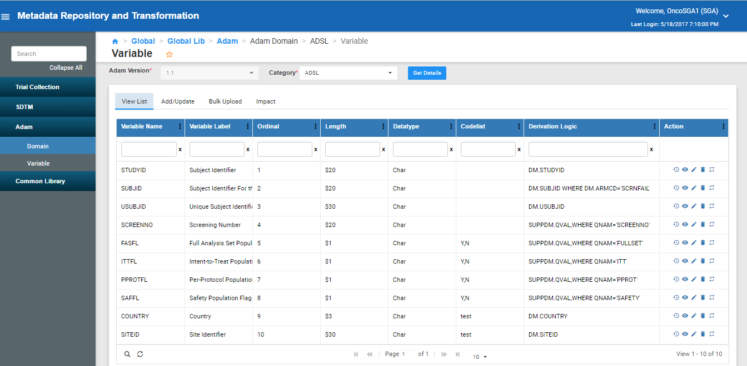
ADaM Metadata – Sample Screen

Slide 50
ADaM Transformation – Categorization of Data and Scenarios
ADaM datasets with mostly standard derivations
(Category 1)
ADSL variables extracted from SDTM domain
Standard derivations of flags (subject level flags)
Date conversions and imputations
Example ADSL, ADAE, ADCM etc…
ADaM datasets with complex derivations
(Category 2)
Standard questionnaire datasets with well defined derivations
Includes complex derivation for AVIST, DTYPE, FLAGS etc.
Complex derivations due to complexity of study design
Complex study designs leading to complex ADaM datasets and derivations
(Category 3)
Studies with multiple phases, multiple treatments etc.
Managing multiple baseline scenarios (BASETYPE)
Record level flags, complex visit windowing (analysis window) etc..
Study specific scenarios and data challenges

Slide 51
ADaM Transformation Strategy – Decision Tree
ADaM Transformation Strategy
Using CDT
Column Map
Table Map
Macro Map
Used for One to One mapping
SDTM to ADaM Variable level Mapping
Used for One to many mapping
To fetch and populate data from multiple SDTM domains
Use for variable / set of variable derivations
Can refer to template codes / macros
Given complexity of ADaM datasets and derivations, CDT is undergoing evaluation and enhancement to facilitate all ADaM scenarios
Supports integration of current global macros (visit windowing, analysis flags etc.)
Facility to include template programs

Slide 52
ADaM Transformation Strategy – Decision Tree
ADaM Transformation Strategy
Decision Tree
Category 1
Category 2
Category 3
Metadata Driven Approach
Hybrid Approach 1
Hybrid Approach 2
Study specific customization done in CDT metadata
Metadata Driven for standard derivation
SAS Macros and Template Program Based
Only Attribute Metadata Captured in CDT
Template codes / SAS macro and programming
Robust governance, semi automation for standards, maintains data lineage / traceability, facilitate study specific SAS programming outside of MDR

Slide 53
ADaM – Synergy and Benefits
Complete traceability and data lineage of each element (CRF/CDASH – SDTM – ADaM)
Facilitates automation around standard data elements and derivations
Components of SDTM directly mapped to ADaM (DM – ADSL, AE – ADAE etc)
Managing standard questionnaires derivations
Managing multiple versions of standards
Robust governance and workflow management
Impact analysis
Version control
Cascading etc…

Slide 54
Thank you

